Slide 1
The Algorithmic Muse: An Introduction to AI
Understanding the History, Mechanics, and Ethics of Synthetic Creativity
Notes:
Today we lay the groundwork. Before we touch the tools tomorrow, we must understand the "Ghost in the Machine.“

Slide 2
What is Artificial Intelligence?
Notes:
Opening Thought: Start by acknowledging the tension in the room. AI is neither a savior nor a destroyer; it is a mirror reflecting centuries of human data back at us.
Objective: To move from "What is this thing?" to "How do we coexist with it?"

Slide 3
Intelligence that has been created artificially

Slide 4
Intelligence that has been created artificially
Possessing knowledge to do something

Slide 5
Intelligence that has been created artificially
Possessing knowledge to do something
Ability to solve a problem

Slide 6
Intelligence that has been created artificially
Possessing knowledge to do something
Ability to solve a problem
Learning must take place

Slide 7
How does the AI learn?

Slide 8




Slide 9







Slide 10
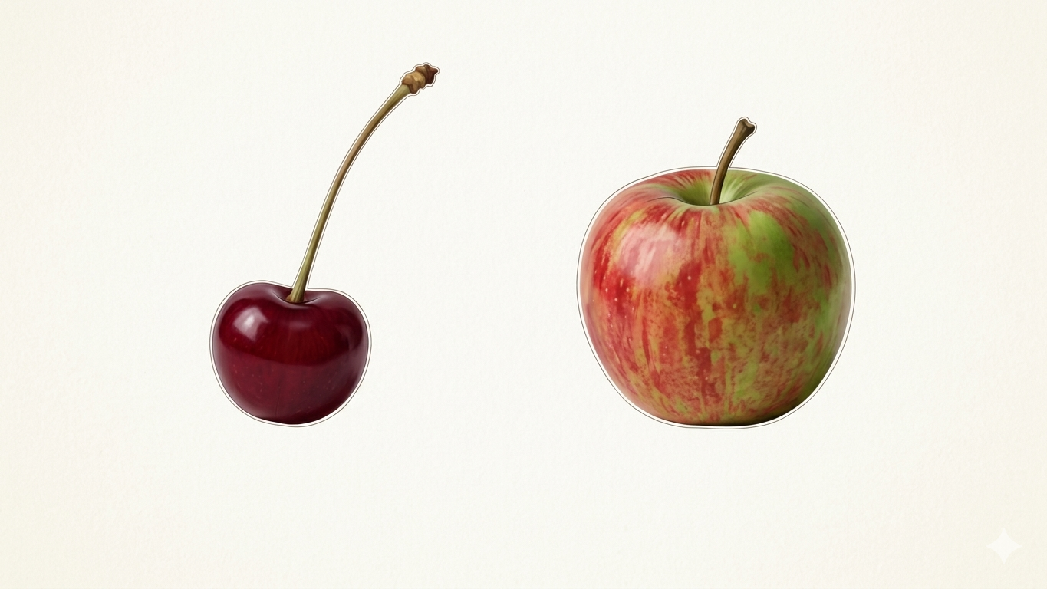

Slide 11
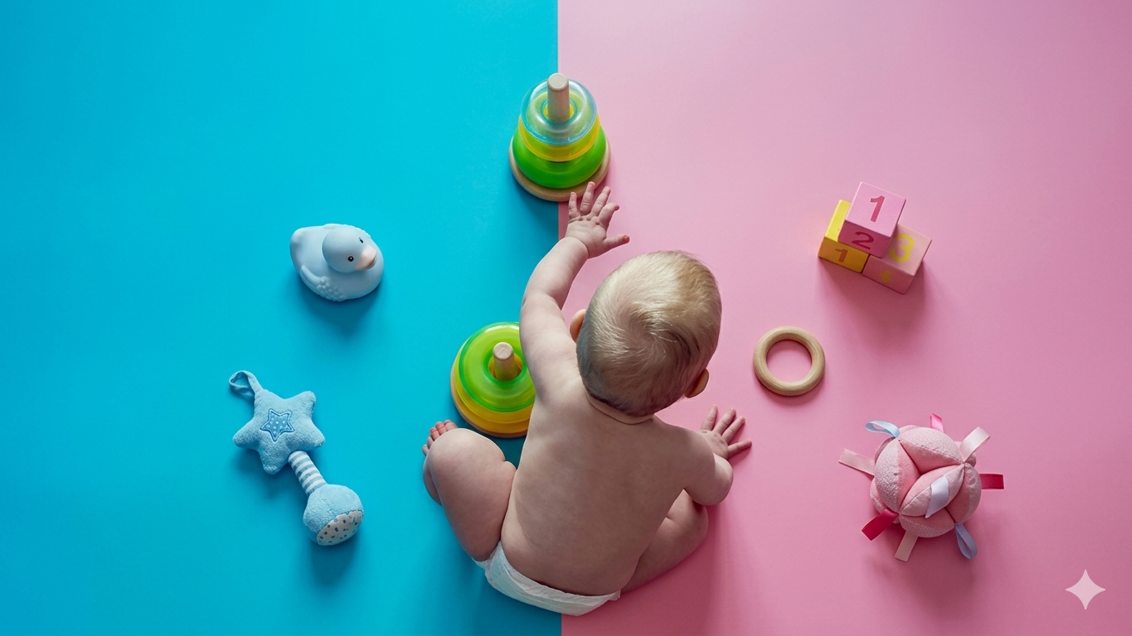

Slide 12
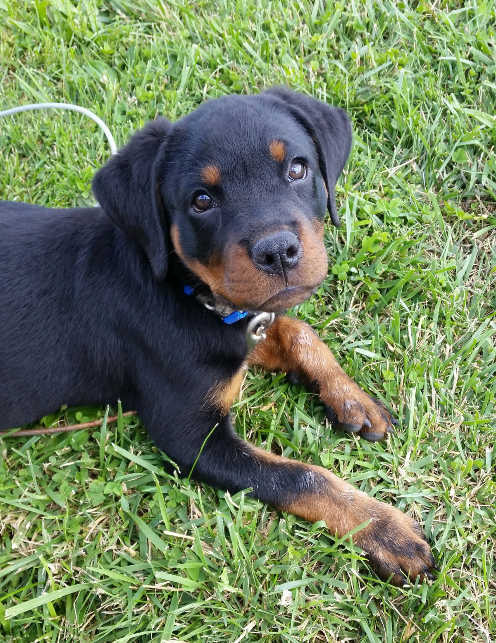
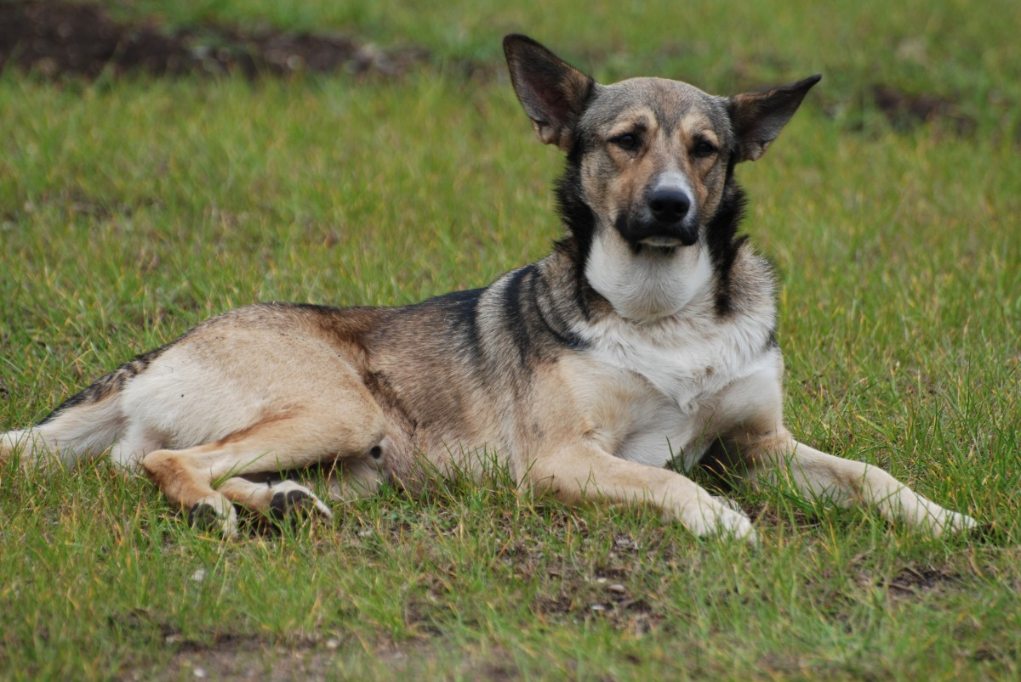
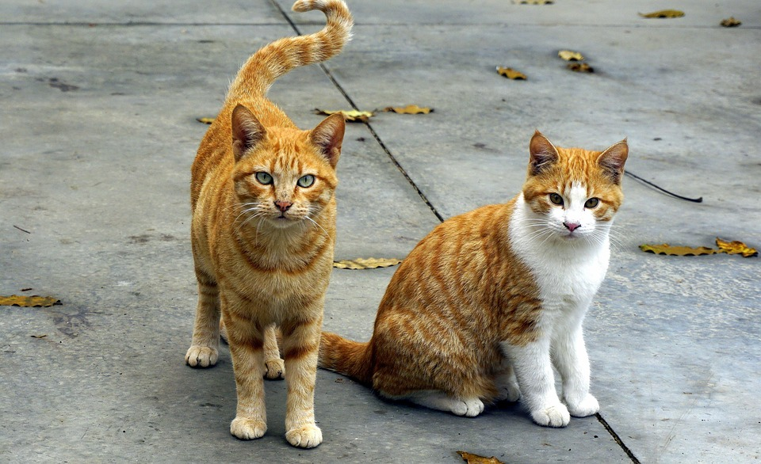
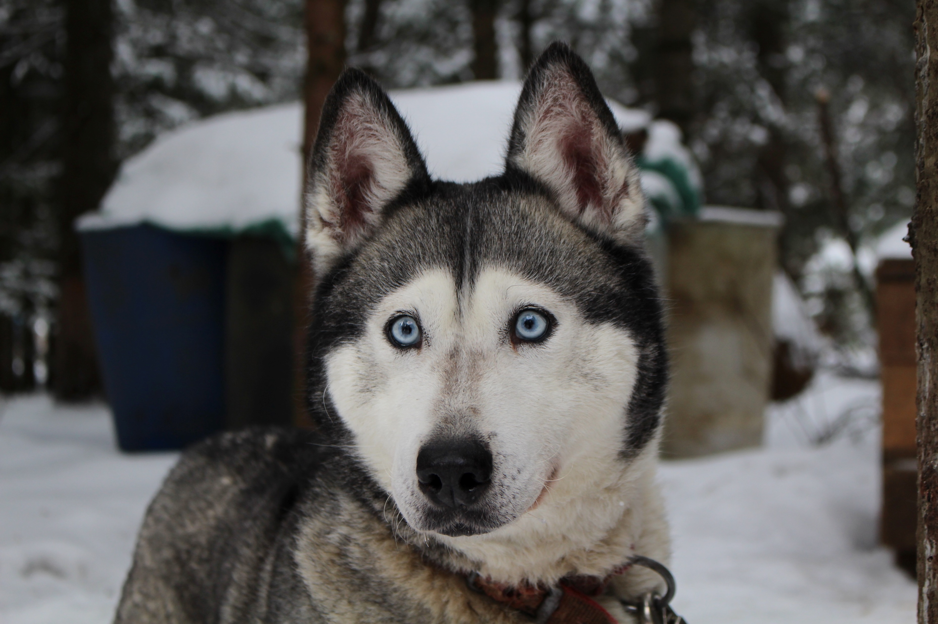
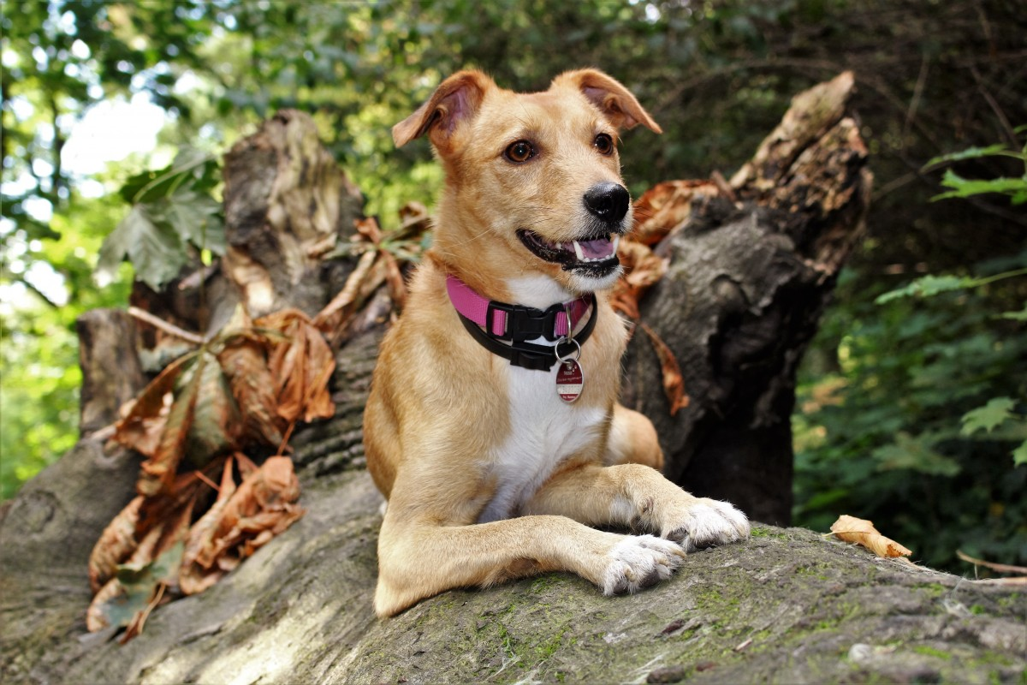
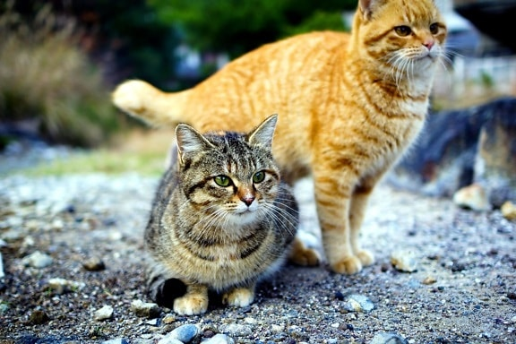
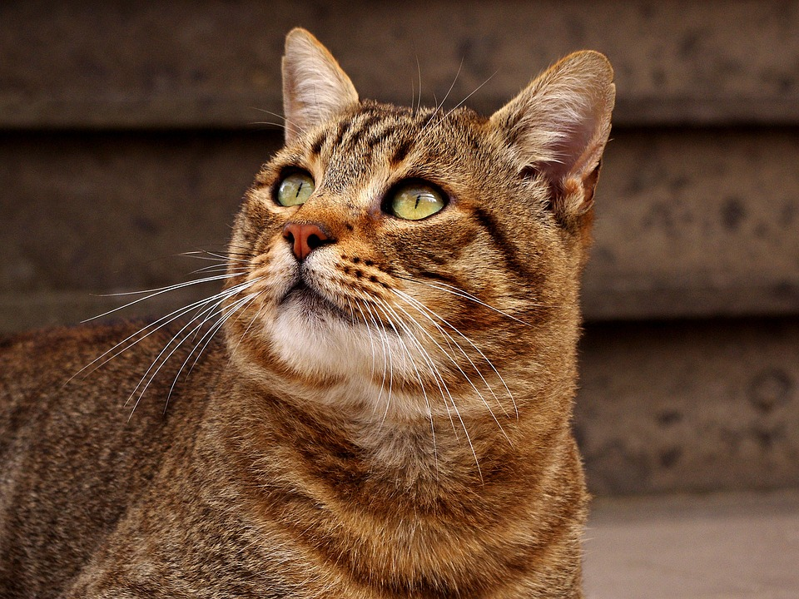

Slide 13
From where is the AI learning?

Slide 14
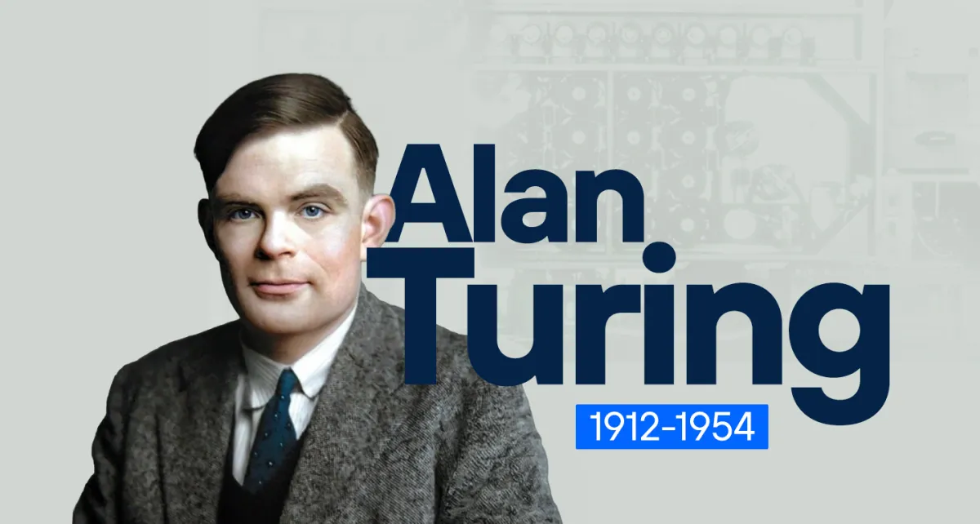

Slide 15
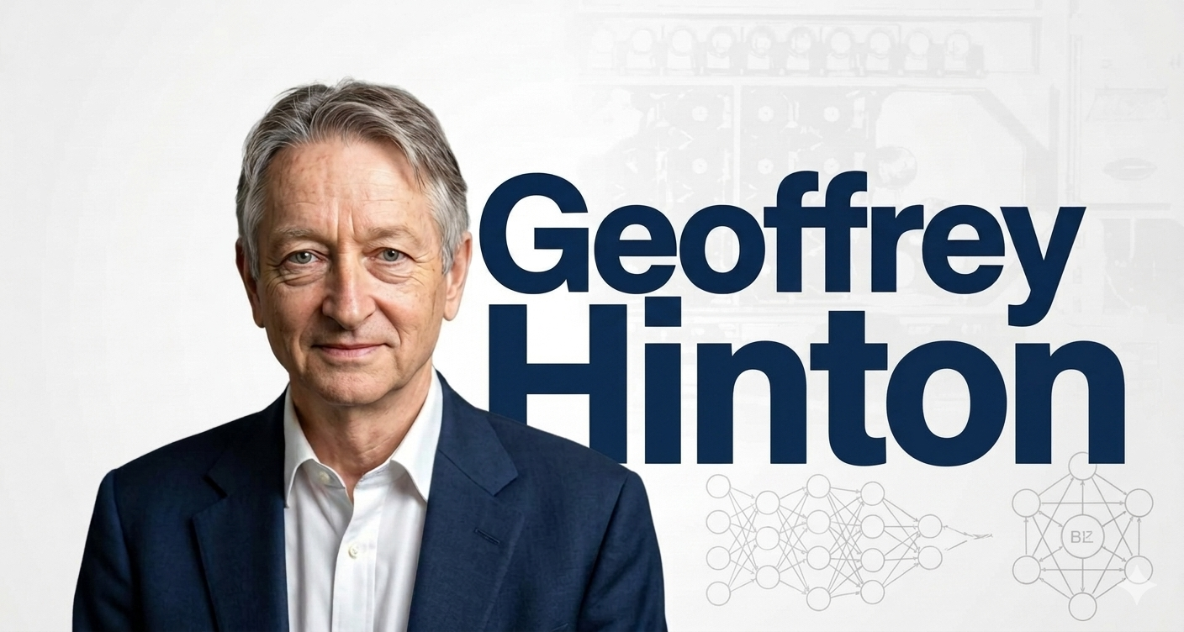
Nobel Prize in Physics 2024

Slide 16
The Engines of Power
Hardware: GPUs (NVIDIA) - Massive parallel processing.
Data: The Open Internet - Every public image, book, and song.
Training: Consuming the sum of human digital output.
Notes:
The Internet as a Library: The "Common Crawl." AI models were "fed" billions of images from Pinterest, Instagram, Getty, and art archives.
Training: It isn't "copying" images; it is "digesting" them into mathematical weights. It learns the concept of a cat, not a specific photo of a cat.

Slide 17
The Timeline of Evolution
1956: The Dartmouth Workshop (The birth of the term).
1990s: Machine Learning (Patterns).
2017: The Transformer Model (The 'T' in GPT (Generative Pre-trained Transformer)).
2022-2026: The Generative Explosion.
Notes:
Darthmouth:
the Overconfidence: They famously (and hilariously) thought they could "solve" the mystery of human intelligence in one single summer.
The Legacy: It shifted AI from science fiction into a formal academic discipline, setting the goal we are finally seeing realized 70 years later.
The "Art" Angle for your talk: > "They believed that even 'style' and 'creativity' were just mathematical equations waiting to be solved. It turns out they were right—it just took a lot longer than a summer vacation to find the math."

Slide 18
Where are we now regarding AI?

Slide 19
Where are we now regarding AI?
Narrow AI (Task-based) vs. GenAI (Generative) vs. Super AI (AGI).
GenAI is the talented student who can mimic any master. Super AI is the entity that might decide that 'Art' as we know it is obsolete. One is a tool in your studio; the other is a paradigm shift we aren't even sure is possible yet
Notes:
1. GenAI (Generative AI)
The Status: This is where we are right now (e.g., Midjourney, ChatGPT, Sora).
The Gist: Unlike "Old AI" that just categorized data (like a spam filter), GenAI creates new content. It analyzes billions of human examples to learn the "math of a style" and then synthesizes original images, text, or music from scratch.
The Art Angle: It is a Synthesis Engine. It doesn't "think," it predicts the next most likely pixel or word based on everything humans have ever uploaded to the internet.
2. Super AI (Artificial Super Intelligence)
The Status: This is theoretical (the "science fiction" future).
The Gist: This is an AI that doesn’t just mimic human tasks, but surpasses the collective intelligence of all humans in every field—from scientific discovery to emotional intuition and artistic originalty.
The Art Angle: While GenAI is a "very fast brush," Super AI would be a "Digital God." It wouldn't need a human to give it a prompt; it would have its own intent, its own "why," and its own creative agency.

Slide 20
What fields has AI already ‘mastered’?

Slide 21
What fields has AI almost already ‘mastered’?
MATHEMATICS
PROGRAMMING
Notes:
2. Super AI (Artificial Super Intelligence)
The Status: This is theoretical (the "science fiction" future).
The Gist: This is an AI that doesn’t just mimic human tasks, but surpasses the collective intelligence of all humans in every field—from scientific discovery to emotional intuition and artistic originalty.
The Art Angle: While GenAI is a "very fast brush," Super AI would be a "Digital God." It wouldn't need a human to give it a prompt; it would have its own intent, its own "why," and its own creative agency.

Slide 22
What about Art?

Slide 23
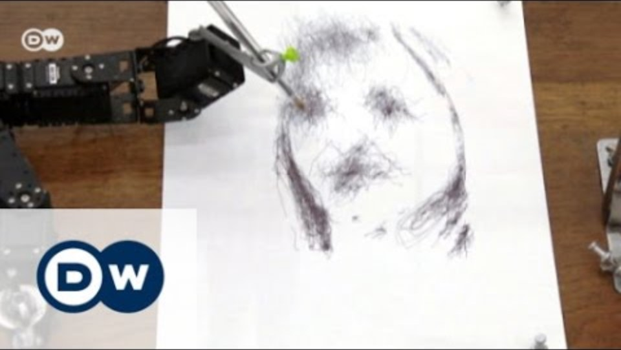

Slide 24
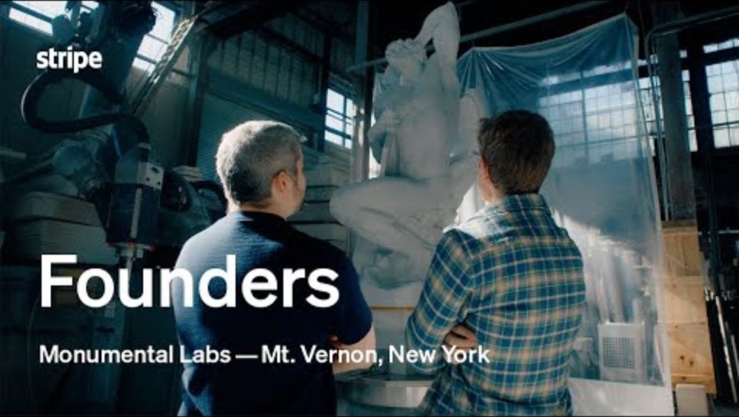

Slide 25
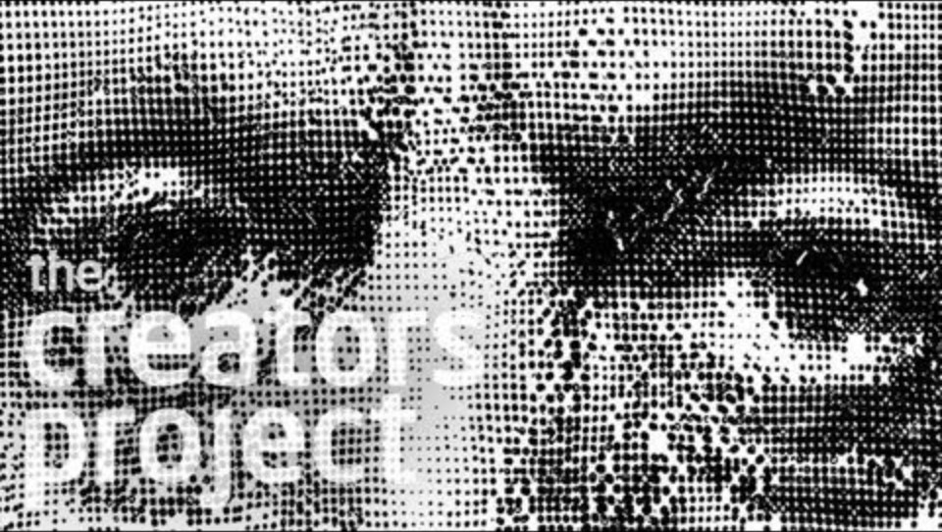

Slide 26
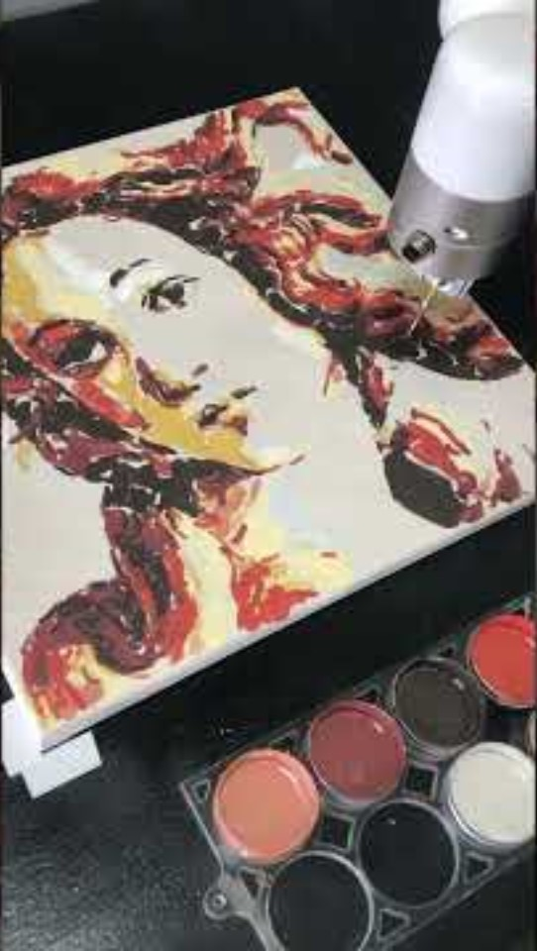

Slide 27
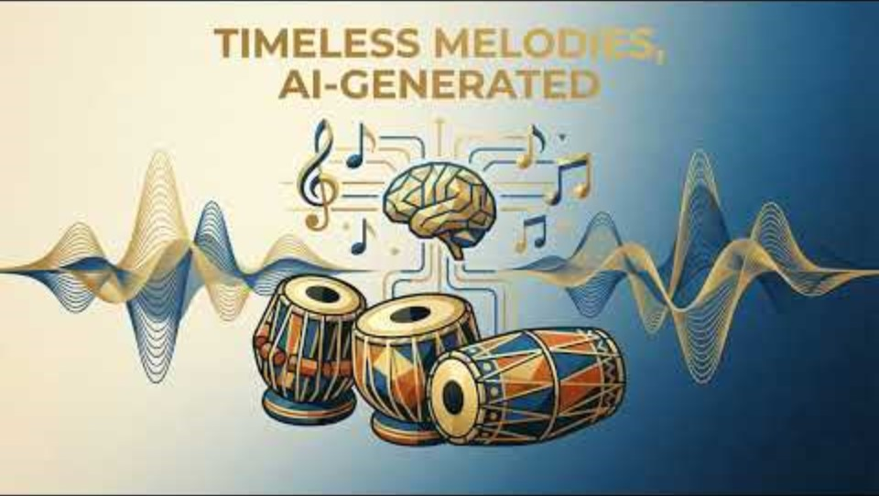

Slide 28
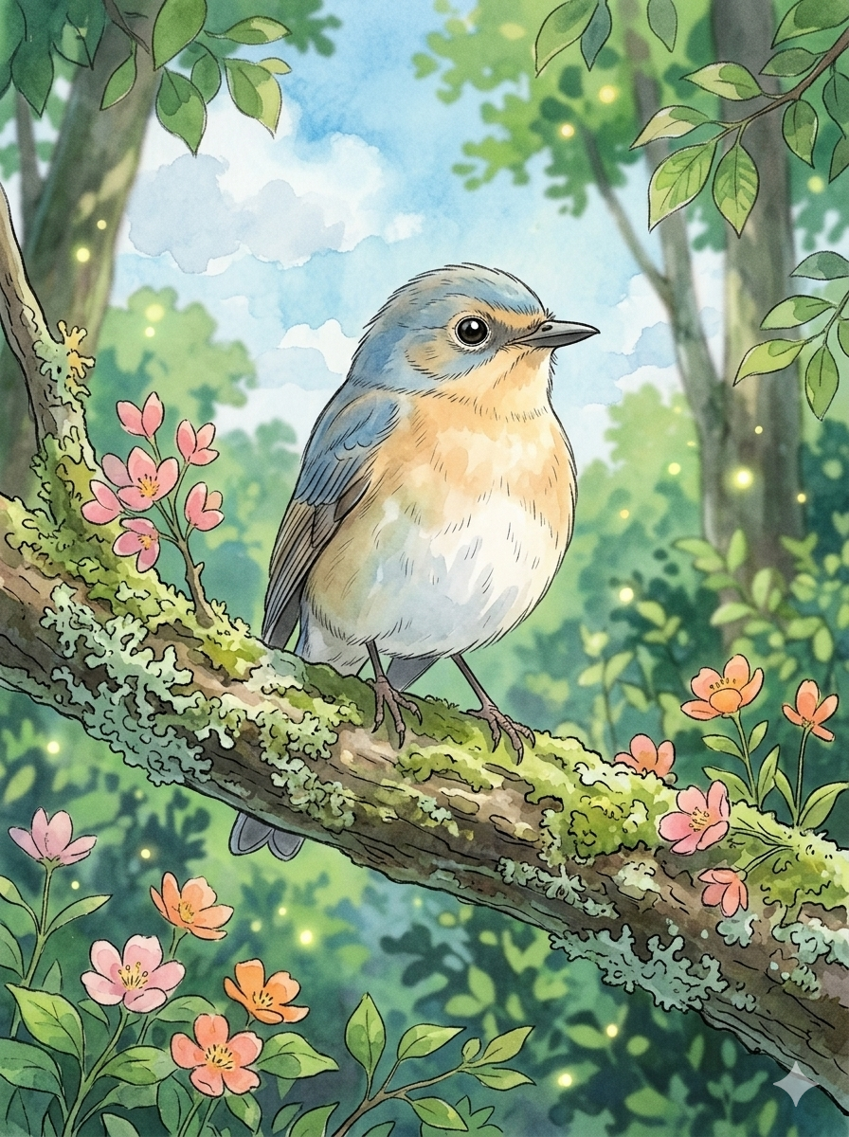
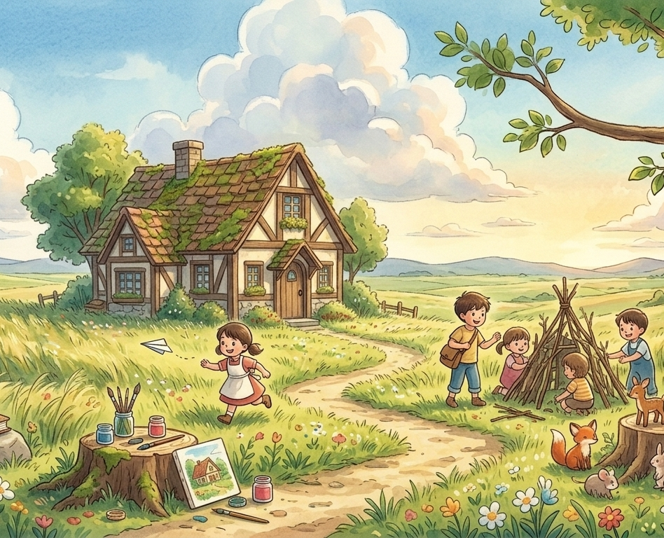

Slide 29
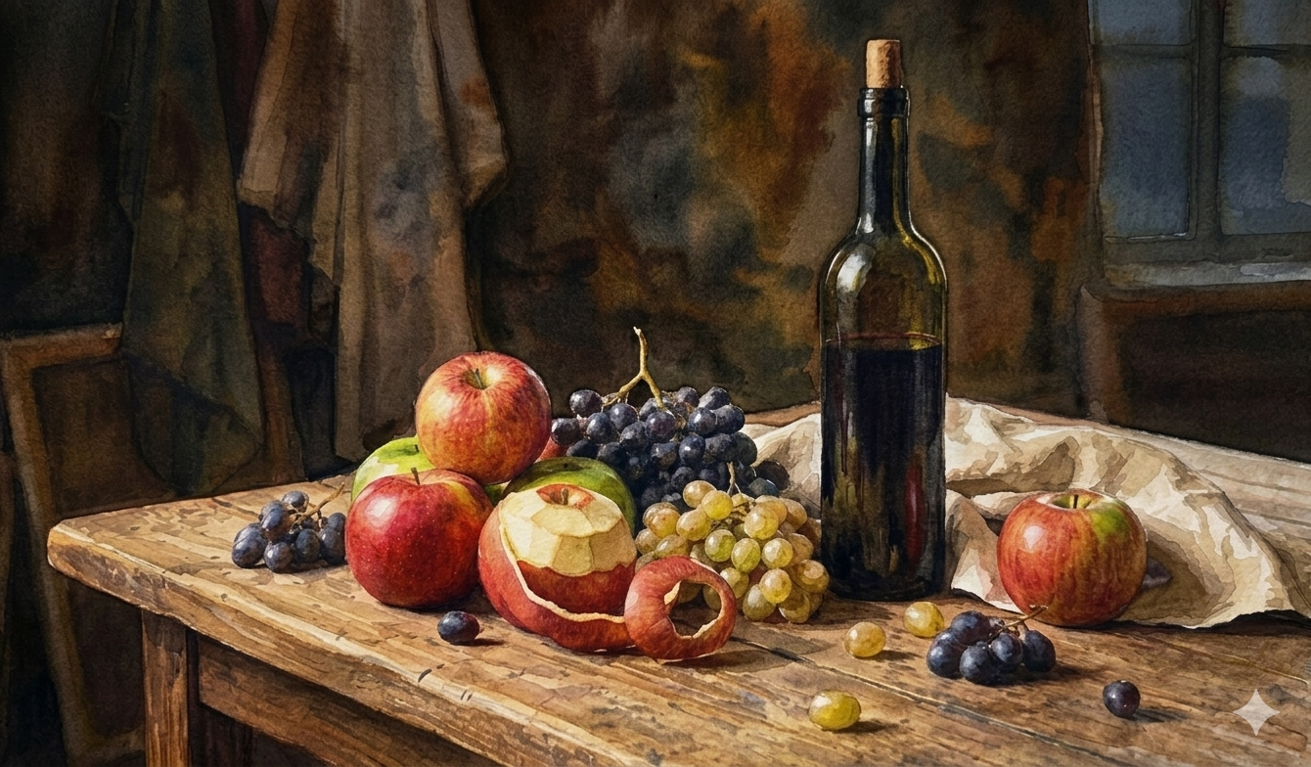
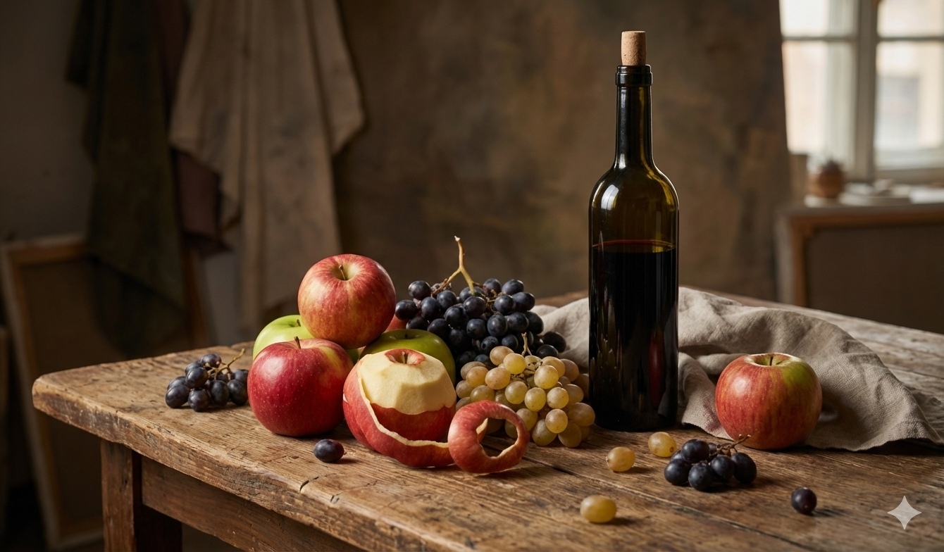
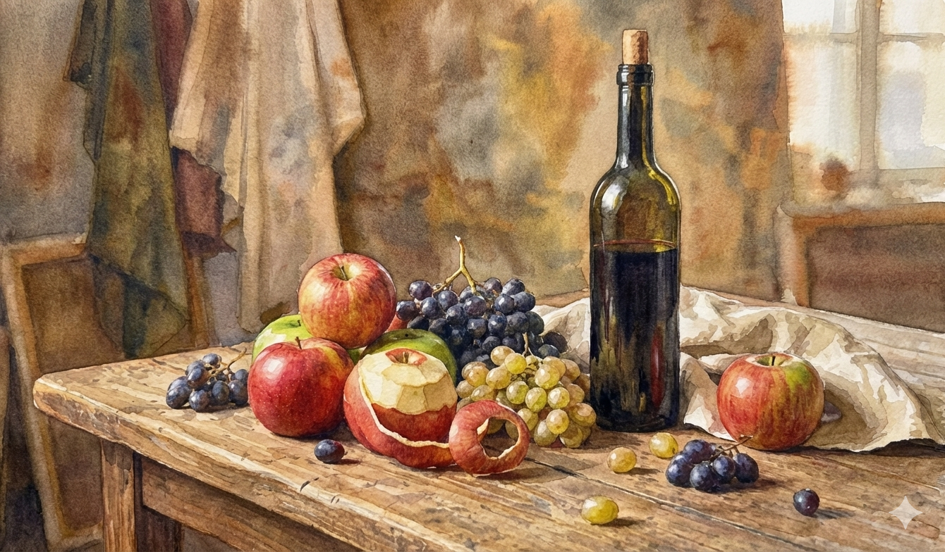

Slide 30
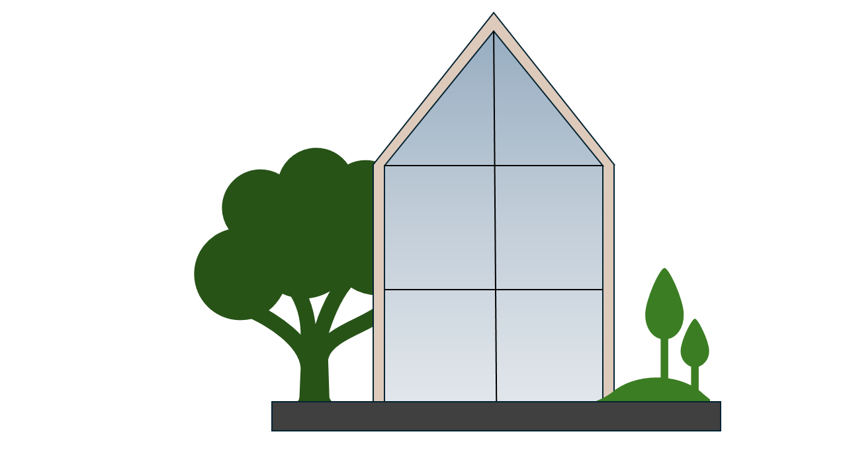

Slide 31
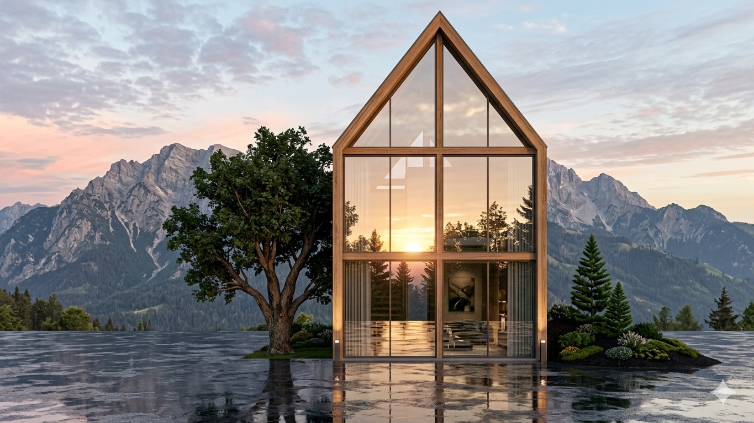
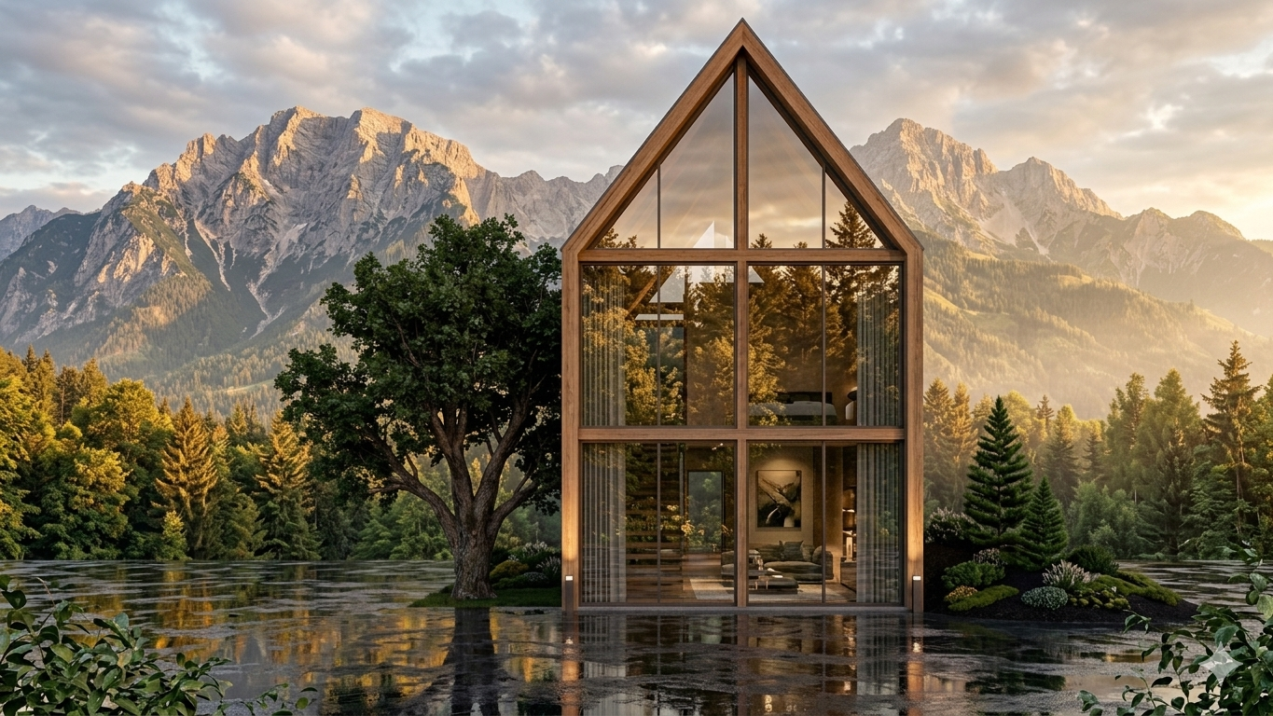
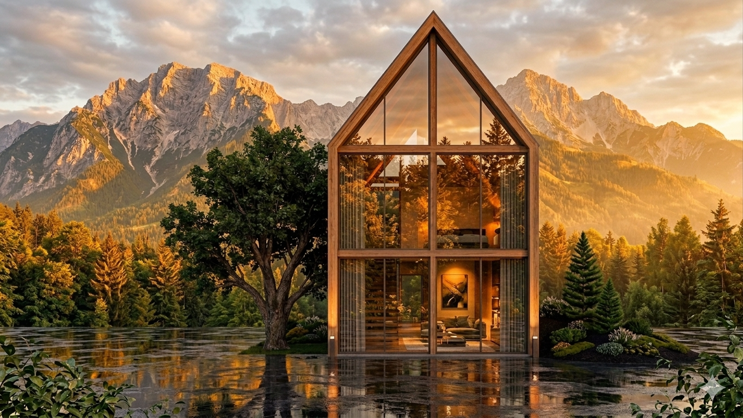
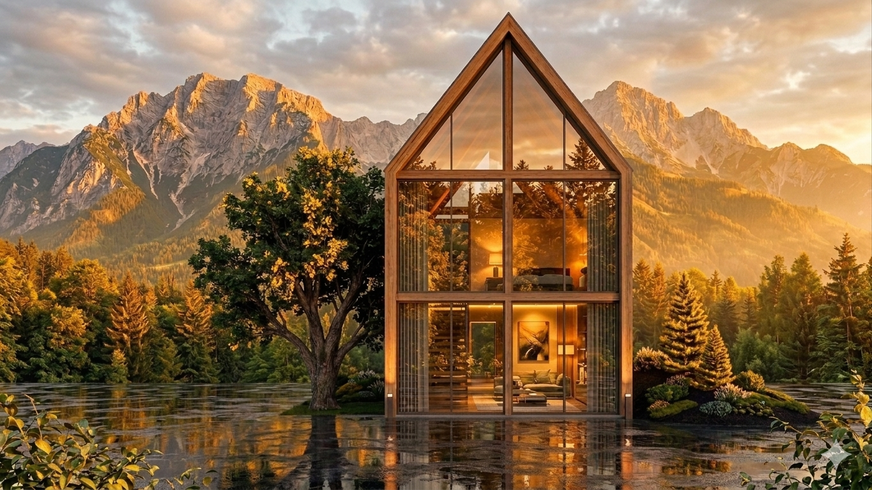

Slide 32
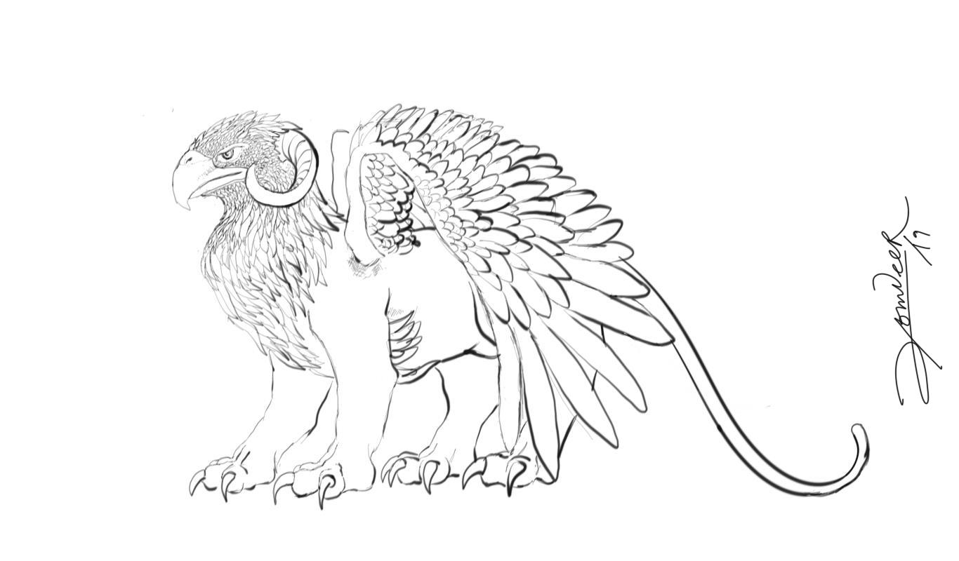

Slide 33
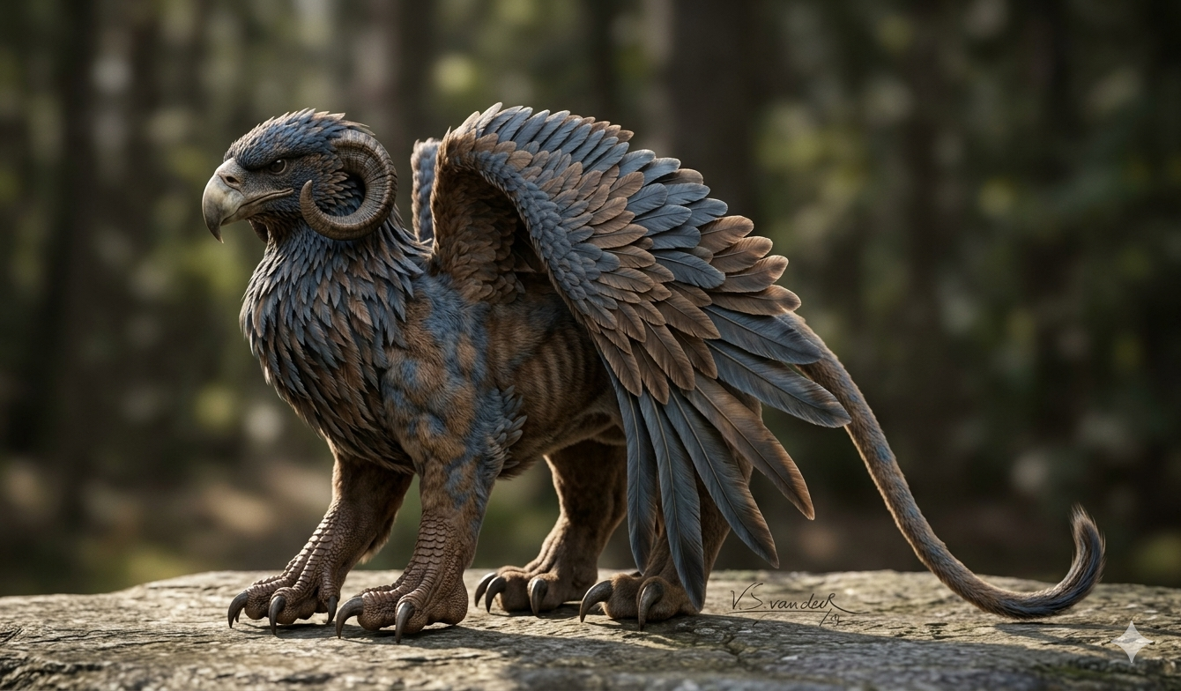
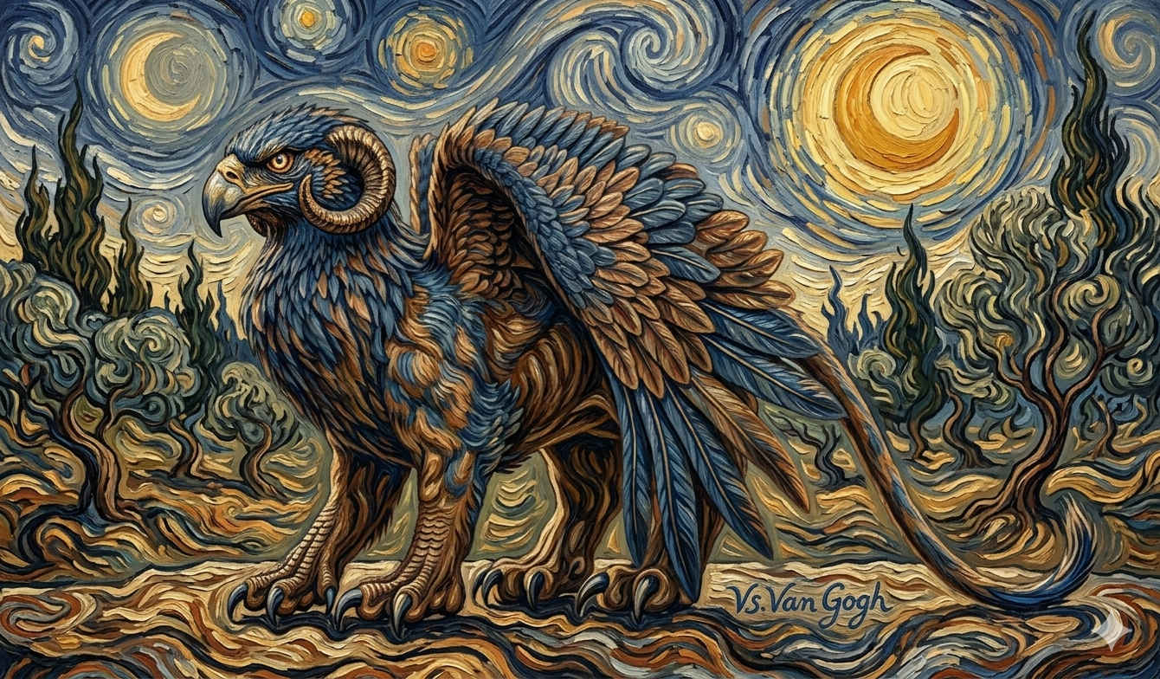
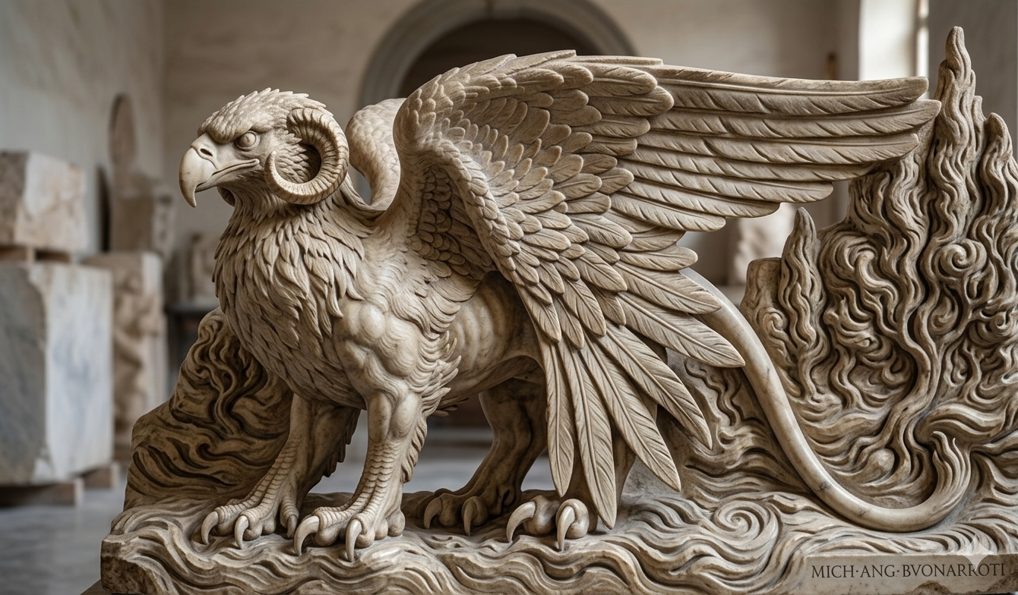

Slide 34
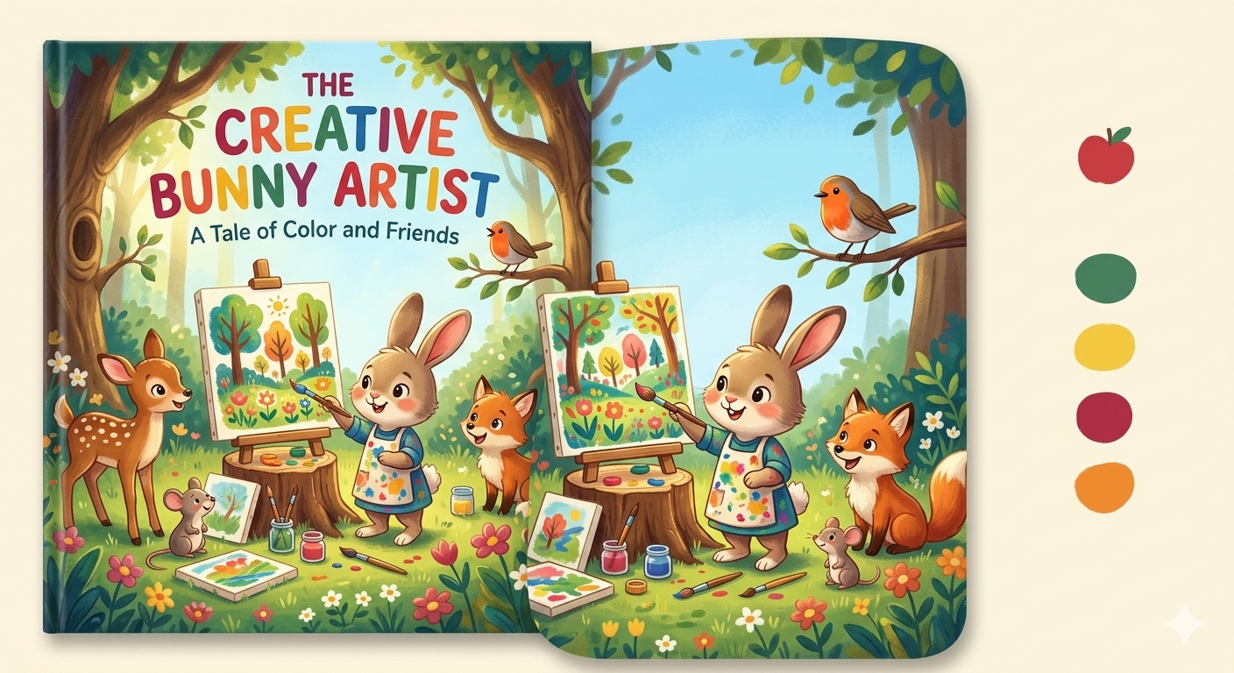

Slide 35
Use Cases: The New Palette
Vision: Image/Logo gen, 3D Rendering, Product Design.
Sound: Music composition, Voice cloning, Podcasts.
Motion: 2D/3D Animation, CGI, VFX.
Physical: Robotics in Sculpture and Architecture.
Notes:
Visuals: Beyond just "pretty pictures." Talk about 3D rendering for architects and product design (e.g., AI-designed sneakers or chairs).
Moving Image: Mention Runway or Sora. We are nearing a time when a single person can generate a high-quality 3D animation from their bedroom.
Robotics: Sculpting robots that can carve marble with the precision of Michelangelo but at 10x the speed.
Physical/Digital Loop: Using AI to generate a pattern, then 3D printing it into a physical textile.

Slide 36
Disruptor or facilitator?
The Camera Obscura: 17th-century 'cheating' or tool for perspective?
The Undo Button (Ctrl+Z): How non-destructive editing changed the 'bravery' of the mark.
The AI Shift: Moving skill from Manual Execution to Conceptual Intent.
Notes:
The Facilitator: It is the ultimate "Assistant." It can handle the boring parts of art (resizing, masking, basic sketching) so the artist can focus on the "Big Idea."
The Disruptor: It disrupts the Economy of Labor. If a company needs a generic logo, they no longer hire a junior designer; they use an AI. This is a legitimate threat to entry-level creative jobs.
Academic Hook: Ask the faculty: "Does the democratization of 'creation' devalue the 'creator'?"

Slide 37
AI as facilitator – Ideation and ‘What if’ Scenarios
Simulating Inspiration vs. Searching for it.
Rapid Iteration: Testing 50 material combinations in 10 minutes.
Stress-Testing: Visualizing 'impossible' combinations (e.g., Mycelium + Rococo).
Failing faster to find the 'truth' of a project
Notes:
In a traditional setting, a "mood board" is a collection of existing things—photos, fabric swatches, or magazine clippings—that represent a vibe.
The AI shift: Instead of finding things that already exist, you are synthesizing the non-existent to test a hypothesis. It’s the difference between "searching" for inspiration and "simulating" it.
Here is a practical example you can use in your workshop to illustrate this to the faculty:

Slide 38
‘Ideation and What if’ - prompt
A large-scale public installation in a brutalist concrete plaza, featuring a translucent sculpture made of iridescent hand-blown glass and bioluminescent fungal networks. The form is inspired by Zaha Hadid’s parametricism mixed with Art Nouveau organic curves. Cinematic lighting during the 'blue hour' at dusk, high contrast, 8k resolution, shot on 35mm lens for architectural depth."

Slide 39
AI as facilitator – Automating the 'Grunt Work'
Saving the Brain, Sparing the Hand.
Rotoscoping: Automating frame-by-frame tracing.
Mask Selection: Surgical precision for hair and complex edges.
Upscaling: Restoring archival images for gallery printing.

Slide 40
AI as a facilitator - Curation – The Art of 'No'
The Shift from Scarcity to Abundance.
The Artist as Director: Making 1,000 choices for 1 final 'cut'.
Interrogating Bias: Breaking the 'Generic AI Aesthetic'.
Visual Judgment: The skill that cannot be automated

Slide 41
The Crisis: Replicating the Master
How? AI learns 'mathematical brushstrokes'.
The Fear: 20 years of mastery vs. 20 seconds of prompting.
The Moral Question: Can you own a 'style'?
Notes:
How it Works (The Latent Space)
Vectors: Everything—a color, a brushstroke, a mood—is turned into a number.
Pattern Recognition: AI learns that "Sunset" usually involves "Orange" and "Horizontal lines."
The Latent Space: Imagine a giant, 3D map. On one side are "Dogs," on the other is "Renaissance Paintings." If you ask for a "Renaissance Dog," the AI goes to the exact coordinate where those two concepts overlap and "paints" what it finds there.
Key Insight: AI doesn't "know" art; it knows the math of art.

Slide 42
The “Style Theft” Crisis
How it replicates masters: Because it has seen every Van Gogh, it knows the mathematical frequency of his swirls. It doesn't "copy-paste" Van Gogh; it "speaks" Van Gogh.
The Mastery Question: If mastery takes 10,000 hours, and AI takes 10 seconds, what happens to the "status" of the master?
The Counter-Argument: Style has always been "stolen" (e.g., Picasso's interest in African masks). AI just does it at an industrial scale.
Notes:
How it Works (The Latent Space)
Vectors: Everything—a color, a brushstroke, a mood—is turned into a number.
Pattern Recognition: AI learns that "Sunset" usually involves "Orange" and "Horizontal lines."
The Latent Space: Imagine a giant, 3D map. On one side are "Dogs," on the other is "Renaissance Paintings." If you ask for a "Renaissance Dog," the AI goes to the exact coordinate where those two concepts overlap and "paints" what it finds there.
Key Insight: AI doesn't "know" art; it knows the math of art.

Slide 43
The Dark Side: Misuse
Deepfakes: Fake doctors, fake political claims.
Brain Rot: Low-quality mass-produced content.
Harmful Content: Non-consensual imagery and 'Misinformation'.
Notes:
Deepfakes: The danger of "Erosion of Truth." If a doctor (or a politician) can be faked, we lose our "Shared Reality."
Brain Rot: This is a term for the flood of low-quality, AI-generated junk content (TikToks, weird Facebook images) that clogs our culture. It’s "Digital Pollution."
Sensitive Data: Address the non-consensual use of images. This is the most significant moral failure of current AI training sets.

Slide 44
Legal and Sanctions
Copyright Law: Currently, the law says "Only humans can hold copyright." This is a protection for artists. If a student uses 100% AI, they don't own the work.
The EU AI Act: Explain that governments are finally stepping in. They are requiring "Watermarking" so we know what is real and what is synthetic.
Fair Use: The biggest legal battle in history is happening now: Is "Learning" the same as "Copying"?

Slide 45
The Future: Adaptation
• Is AI Conscious? No. It mimics, it doesn't feel.
• Human Value: Intent, Emotion, and Ethical Curation.
• The Goal: From 'Laborer' to 'Director'.
Notes:
Is it Conscious? No. It is a "Stochastic Parrot." It predicts the next likely thing based on the past. It has no "inner life."
Human Relevancy: Our value is in Curation and Intent. AI can make a thousand images of a "Lonely Man," but it doesn't know what "Lonely" feels like. Only a human can choose the one image that truly communicates that feeling.
Reassure them: Computers didn't kill math; they made us better at physics. AI won't kill art; it will make us better at Visual Philosophy.

Slide 46
Discussion: Will AI Replace Us?
Food for thought: If the craft is automated, what is the value of the artist?
Notes:
The "Replacement" Debate: Use this to end the day.
The "Yes": AI will replace the technical laborer (the person who just "draws what they are told").
The "No": AI cannot replace the Visionary.
Closing Food for Thought: Ask them: "If an AI makes a masterpiece and there is no human around to see it, is it still art?"
Goal: Leave them thinking, so they come back for the "Hands-on" Workshop on Day 2 ready to master the tool.

Slide 47
"AI will not replace the artist. However, an artist using AI will eventually replace an artist who doesn't."

